Slide 1


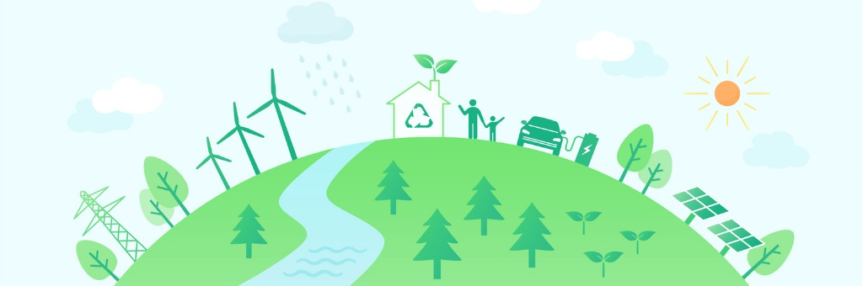
UN Sustainable Development Goal 7 Access to Clean Energy
Team – JARVIS

Slide 2
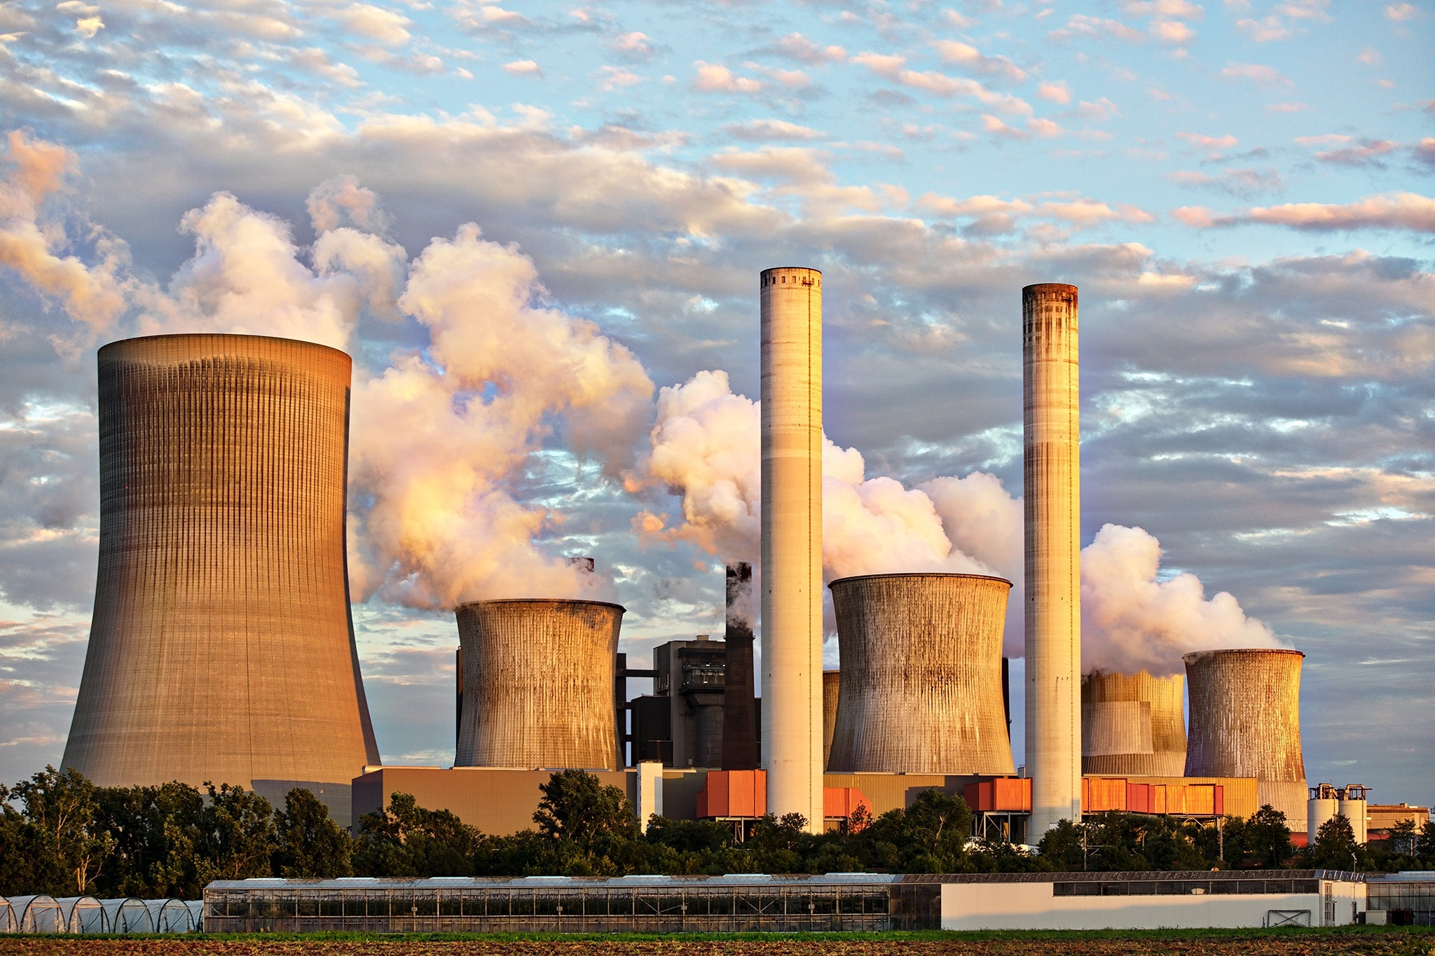
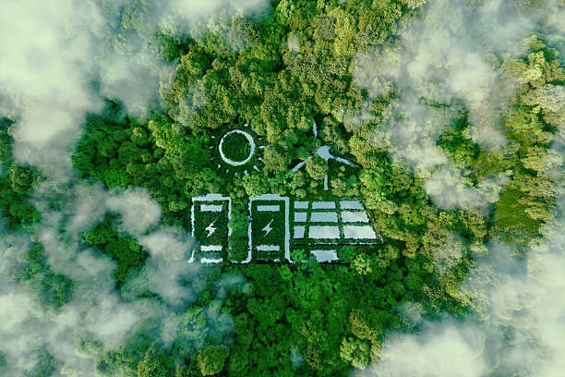
Agenda: Presentation Highlights
Current electricity generation scenario
Canada’s performance
Findings
Next steps

Slide 3













Energy: Global Consumption
Increased usage of non-renewables has led to global warming. Earth’s temperature has risen by 1.1°C in the last 100 years, 2/3rd of increase is since 1975.
Non-Renewables account for 84% of energy consumption
Renewables are only 16% of energy consumption
624 EJ Total Primary Energy Consumption
Coal
Petrol
Natural Gas
Nuclear
2022 - 6th warmest year in 143 years, 1.55 F increase
It leads to 40% of net GHG emissions
28334 TWh Total electricity produced
36639 Mt CO2 emission
Notes:
2021 was 7th warmest temp rose 1.11 degree

Slide 4







Electricity: Global Production
World’s oil reserves will run out by 2052, natural gas by 2060 and coal by 2090.
Increased usage of renewable resources will lead to sustainable development.
LCOE production- $ 0.13 per KWH
71% Non-Renewable Sources
LCOE Production- $ 0.05 per KWH
29% Renewable Sources
Global Electricity Production 28334 TWH
AFFORDABLE
Sustainable
Development Goals
ACCESS TO CLEAN ENERGY
MODERN
RELIABLE
6th largest producer
4th largest consumer
Per Capita
SUSTAINABLE
Notes:
Make font bold

Slide 5


Electricity from Renewables 2017-2021 (TWh)
Race to Renewables
It is high-time for Canada to wakeup and accelerate towards renewables.
Compound Annual Growth Rate(CAGR)
: 6.03%
: -0.5%
7885.04
7478.99
7010.58
6649.75
6239.71
Canada’s STAGNANT growth!!
435.43
428.39
421.80
429.24
426.71
2017
2018
2019
2020
2021
World
Canada

Slide 6



Canada’s Goal 7: Ambitions & Targets
Reduce
600
90%
Per Capita Energy Consumption
petajoules of total annual energy savings by 2030 at consumer end
electricity generation from renewable and non-emitting sources by 2030 and 100% in the long term

Slide 7


Energy Consumption Trend
Per capita energy consumption is NOT depicting a decreasing trend contrary to what is planned.
Per Capita Energy Consumption (TJ)
0.23
0.23
0.23
0.24
0.24
66.73
35.6
26.7
27.4
2015
2016
2017
2018
2019

Slide 8


Energy Savings Trend
Annual energy savings are increasing as a result of energy-efficient codes, standards and practices. However, the target of 600 PJ by 2030 seems like a Herculean task!
Annual Energy Savings (PJ)
80
66.73
35.6
Target of 600 PJ by 2030!
27.4
26.7
2017-18
2018-19
2019-20
2020-21
2021-22

Slide 9




Transition of Renewable Electricity Generation
Even though Canada’s electricity generation from renewable resources is on a rise, greater efforts are required to reach the target of 90% by 2030.
% of Total Electricity Generated from Renewables (2017-2050)
90%???
74.85%
76.68%
70.47%
72.37%
68.31%
67.64%
66.38%
66.72%
66.34%
2017
2018
2019
2020
2021
2022
2030
2040
2050

Slide 10
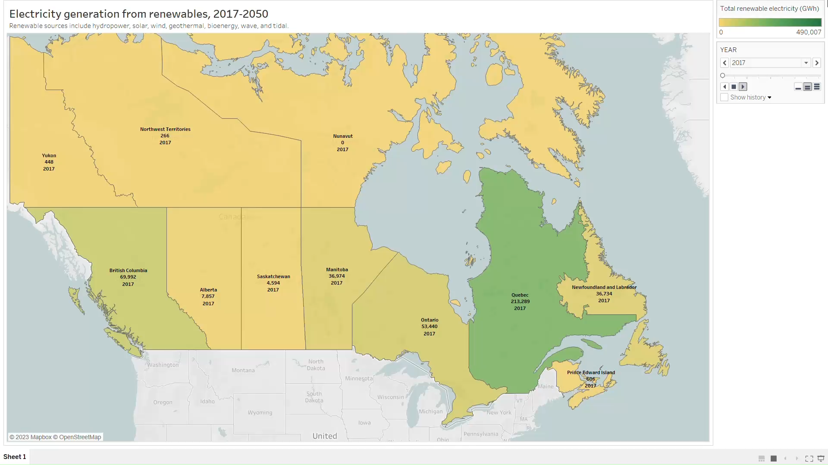
Renewable Electricity Distribution across Provinces
Northern Territories rely primarily on non-renewable resources. They should urgently shift their focus towards renewable resources.
Government of Canada

Slide 11


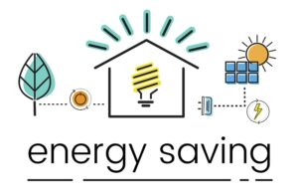

Actions & Incentives
Phase-out of conventional coal-fired electricity by 2030
Green and Inclusive Community Buildings Program
Natural Resources Canada (NRCan) Funding to Energy Innovation Projects For Renewable Resources (in Millions)
$175.76
$2.6B to help homeowners make energy efficient retrofits through grants, energy assessments and low-cost loans
$81.09
$51.70
$69.11
2019
2020
2021
2022
$2B in energy efficiency retrofits for large-scale buildings
$1.5B for Clean Fuel Funds

Slide 12

How do We Contribute ???
Energy efficient buildings:
Air sealing, home insulation upgrades
Solar panel installations
Motion sensors for lights/water
Investments in clean energy production:
Utilize subsidies for EV vehicles & EV charging stations
Access grants up to $5K and low-cost loans up to $40K
Other measures:
Green vehicles on campus for transportation
Use efficient hot water supply instead of traditional sources

Slide 13

Thank you for your attention! Any questions

Slide 14
Sources
https://yearbook.enerdata.net/electricity/share-electricity-final-consumption.html
https://www.iea.org/reports/key-world-energy-statistics-2021/supply
https://www.visualcapitalist.com/electricity-from-renewable-energy-sources-is-now-cheaper-than-ever/
https://www.cer-rec.gc.ca/en/data-analysis/energy-markets/market-snapshots/2022/market-snapshot-why-canada-is-one-of-the-worlds-largest-electricity-consumers.html
https://yearbook.enerdata.net/electricity/share-electricity-final-consumption.html
https://www.iea.org/reports/key-world-energy-statistics-2021/supply
https://sdgcif-data-canada-oddcic-donnee.github.io/7/
https://open.canada.ca/data/en/dataset/5a6abd9d-d343-41ef-a525-7a1efb686300

